Slide 1

Fostering Authentic, Sustainable
Community-led Development
Lessons from our National Chapters
Partos Gathering, October 14, 2021
The Movement for Community-led Development
Dr. Daisy N. Owomugasho
Director, The Hunger Project, Uganda
East Africa Coordinator, The Movement for CLD

Slide 2
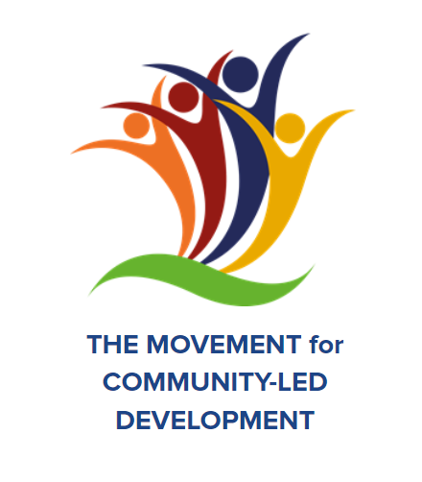
What is a community?
Community is simply…
People living together; People with common interests; People with common characteristics; People with similar natural experiences; People with common traditions and cultures; People with common beliefs……these are just a few of the aspects that define a community.

Slide 3
Basis of a community
Community
Geography
Interests
Characteristics
Identity
Preferences
Traditions
Beliefs
Identity outweighs all characteristics that define a community and this is recognised through the tradition and beliefs that are usually upheld within the social systems through which decisions guiding the people are made. These systems are usually held high and respected by the respective communities

Slide 4
Who can speak on behalf of the community?
Leaders within the social system (religious systems, cultural systems)
People identified and entrusted by the communities (elected leaders such as, local council leaders, district local leaders, members of parliament)
Community members identified within the geographic area or locality. But also could be people with similar identity. These could be people with common visions, interests, views, inspirations, and experiences. Those with ability to guide and steer common goals. These can be identified as CBOs, community groups and associations such as, women groups, youth groups, disability groups, etc.

Slide 5
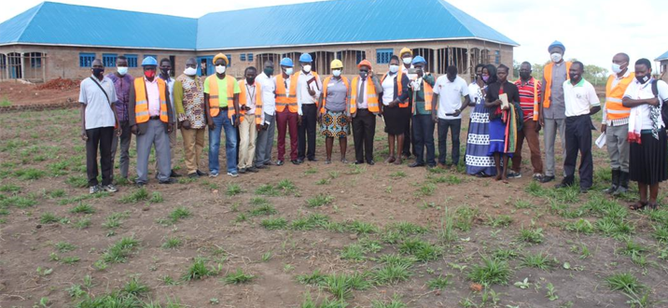
The Movement for Community-Led Development
DEVELOPMENT IS LOCAL

Slide 6


The Movement for Community-led Development
Vision: Community-led Development
Dignity, voice, and agency for all as the best way to end poverty
Shift the power to address poverty, and reverse growing inequality and climate change.
How? By rolling out Community-led Development across countries
Platform:
Tools:

Slide 7
The Movement for Community-led Development
Vision: Community-led Development
Shift the power to address poverty and reverse growing inequality and climate change.
How? By rolling out Community-led Development across countries
Platform:
Social Movement
Co-creating a way forward, and journeying together
Tools:

Slide 8
The Movement for Community-led Development
Vision: Community-led Development
Shift the power to address poverty and reverse growing inequality and climate change.
How? By rolling out Community-led Development across countries
Platform:
Social Movement
Tools:
Systems practices
Ways to create and manage collective change that lasts

Slide 9
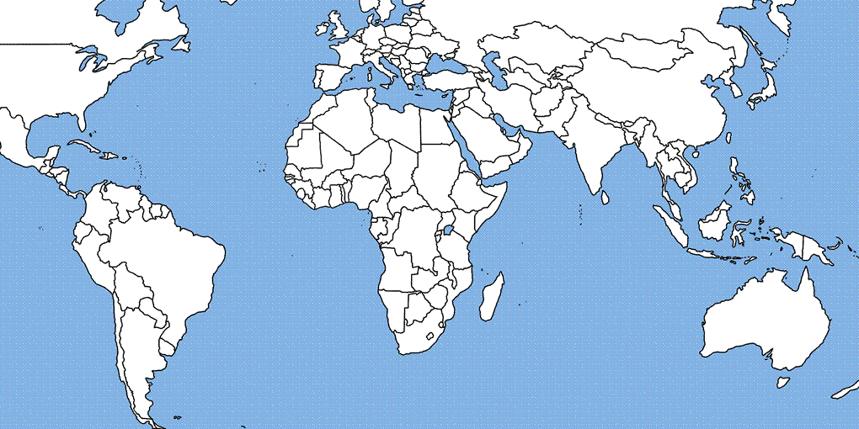
The Movement for Community-led Development
National Chapters as of October, 2021
Netherlands
USA
Mexico
Sierra
Leone*
Guinea
CAR
Liberia*
Ghana
Togo
Benin
Nigeria*
Ethiopia
Rwanda
DR Congo
Kenya
Uganda
India
Philippines
Haiti
Venezuela
Colombia
Malawi
Zambia
Key
- Formal Chapter
- In development / participating
* Launched in 2020
*Launching in December, 2021

Slide 10
Stakeholders in each country:
Local, middle, and national civil society organizations
Individuals who are passionate about locally-led development in their country
International NGOs
Governments
Private Sector
Creatives: artists, musicians, dancers, writers
Think tanks, thought leaders, influencers
Academia
Others!
National Chapters
Everyone is welcome!

Slide 11
National Chapters
Global Movement
Stakeholders in each country:
Local, middle, and national civil society organizations
Individuals who are passionate about locally-led development in their country
International NGOs
Governments
Private Sector
Creatives: artists, musicians, dancers, writers
Think tanks, thought leaders, influencers
Academia
Others!
Int’l Stakeholders:
International NGOs
Donors (USAID, etc)
Multilaterals (UN, World Bank, etc.)
Global civil society
Academia & Research
Think tanks, thought leaders, influencers
Everyone is welcome!
No cost to participate--only commitment to CLD

Slide 12
National Chapters
Self directed, self governed
Passionate people, volunteer driven (including people who get paid by their own organizations)
Co-creating their own visions of community-led development for their country, and plan to get there.
Cultivating a pipeline of leaders, including those who represent the “lived experience” of the community realities.
Fueled by and for grassroots voice and agency of local communities
Foster solid partnerships at all levels--from local to intermediate to national to international

Slide 13
National Chapters: Theory of Action & Change
National engagement and mobilization
National
Partnerships
Transformation
Decentralization and Devolution
- Shared aspiration
- High leverage
efforts
- Learn & adapt
- Continuous
engagement
More and better CLD:
Dignity and Justice for People and the Planet
National Movement Chapters
Convergence: Systems Change
Evidence + guidance
Early changes: including capacity & commitment
Country-owned, embedded
locally-led dev.
Tailored experience and evidence:
Healthy, productive, resilient, self-reliant communities
Facilitation / Implementation
Partnerships
Community-led development
in practice

Slide 14

Gems: Learning as we go
Didn’t really take off
INGO staff / office:
Lack of interest
Other pressing priorities
Not funded (country offices often driven by project funding)
Not linked to INGO home / country office strategies
Already INGO groups in many countries (with different goals)
Lack of agency to form new partnerships
Holistic approach doesn’t map well to sector silos
Gap between INGO global staff who were linked to Global Chapter and INGO country staff
Original MCLD National Chapter model:
INGOs who were members of the Global Chapter would fuel the National Chapters

Slide 15
Gems: Learning by doing
Original MCLD National Chapter model:
INGOs who were members of the Global Chapter would fuel the National Chapters
Didn’t really take off
Domestic civil society:
Lack of voice and agency, passive attitude
Intimidated by perceived INGO power dynamics: traditionally are “subs” to INGOs
Assumed it was about getting funding opportunities
No idea what else it might be--lack of experience with “movements”

Slide 16
Lessons Learned: What did work?
When the INGOS didn’t really show up, the domestic groups found their voices
Having National Chapters that are by, for, and about domestic civil society is working
Helping them understand that this is not about the top-down approach takes time and deep discussion: new tone and kind of relationship building
Once grasped the true nature of the proposed "movement" alternative--where they are the true leaders and wise visionaries and actors--that's when things started to happen
This new platform delivers real value
Structure: Essentially about convening good people and organizations, creating a catalyzing space and processes, and building on what emerges

Slide 17
What did work?
INGOs who are truly committed to CLD DO offer important value to National Chapters.
They offer:
capacity development and learning opportunities
demand-driven technical support
recognition and solidarity (which, turns out, is SO important)
credibility (association with Global Movement)
Networking: offering in-country and int’l connections and reference
They gain:
meaningful relationships with genuine domestic civil society--valuable in myriad ways--#shiftthepower

Slide 18
What did work?
When the domestic groups took over, the unique and added value of a National Chapter emerged
National Chapters that are by, for, and about domestic civil society
Widespread and inspirational engagement and participation
Peer learning across Chapters is really important
Lots of diverse and meaningful accomplishments (Benin, Malawi, Uganda, Nigeria, Liberia)
Small grant fund (one $5K grant per chapter--diverse and exciting take up)

Slide 19
Case Study: R2G and Uganda National Chapter
Right2Grow Project: breaking new ground in terms of demonstrating new ways international projects can partner with National Chapters / Domestic Civil Society
Potential value of International / Domestic Civil Society partnerships
Enable reach to most neglected locales via most appropriate CSOs--these CSOs are often smaller, less formalized, more remote, or combination of all.
Can enable practical and tailored capacity development for diverse participating CSOs--capacity to develop their own voice and agency, individually and collectively
Cost effective--local organizations have lean and local model
Improves quality--genuine and appropriate programming conceived and delivered by people with lived experience and proximate leaders
Ways this will contribute to sustainability after R2G ends.

Slide 20
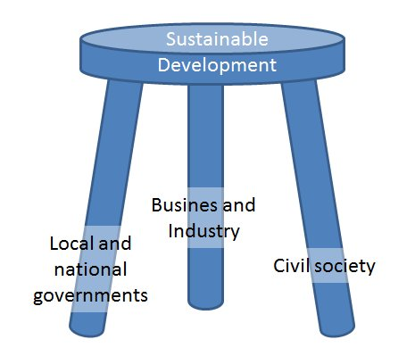
What defines a community; geography, identity, or both? And based on the chosen definition, who are the representatives that can speak on behalf of that community?
Our top line:
Communities are multifaceted and always changing. They represent shared geography, various identities, shared history, or other ideas.
Every society should have a diverse and thriving domestic civil society, offering multifaceted representation on any given day, for any given community.
Civil society is underdeveloped and/or unrecognized in many African countries. Much of this is the legacy of colonialism and neo-colonialism. This needs to be rectified, as it has been in Indonesia, fueled by a 20+ year program of civil society reform.
Civil society should:
exist at levels--local, middle, national
be networked
be fed by a pipeline of leaders, volunteers, professionals of all stripes.

