Slide 1
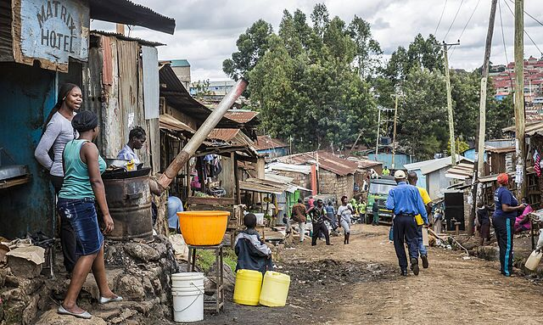
How can iNGOs support collective action in informal settlements during a crisis?
Towards new ways of working

Slide 2
Theory of change Urban agenda of CFIA & VCC
Problems
Informal settlements are vulnerable to shocks
Output
Conditions for and limitations of frugal innovations and adaptive governance
Outcome
Impact
Local frugal innovation can be a way to address scarcity caused by the disaster.
Immediate support to frugal innovations during crises
Links with exteral actors are often weak
Partnerships for impact
Long term system change
New ways of working:
More resilient informal settlements
Visualised frugal innovations

Slide 3
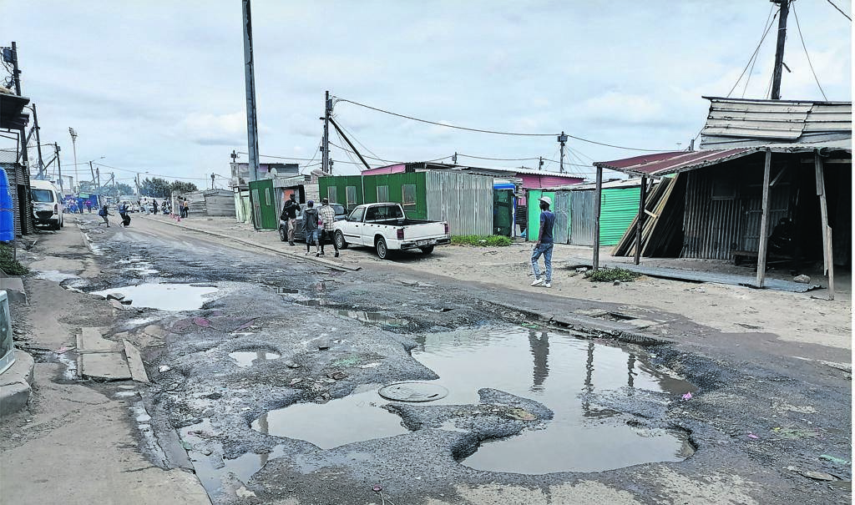
Resilient informal settlements
1 billion informal settlers
Vulnerable to multiple shocks and levels
Agency: a lot happens but is often low quality, invisible, unconnected
Individuals
Households
Collective action
(informal) firms
External actors
External support often fails
The pothole metaphor

Slide 4
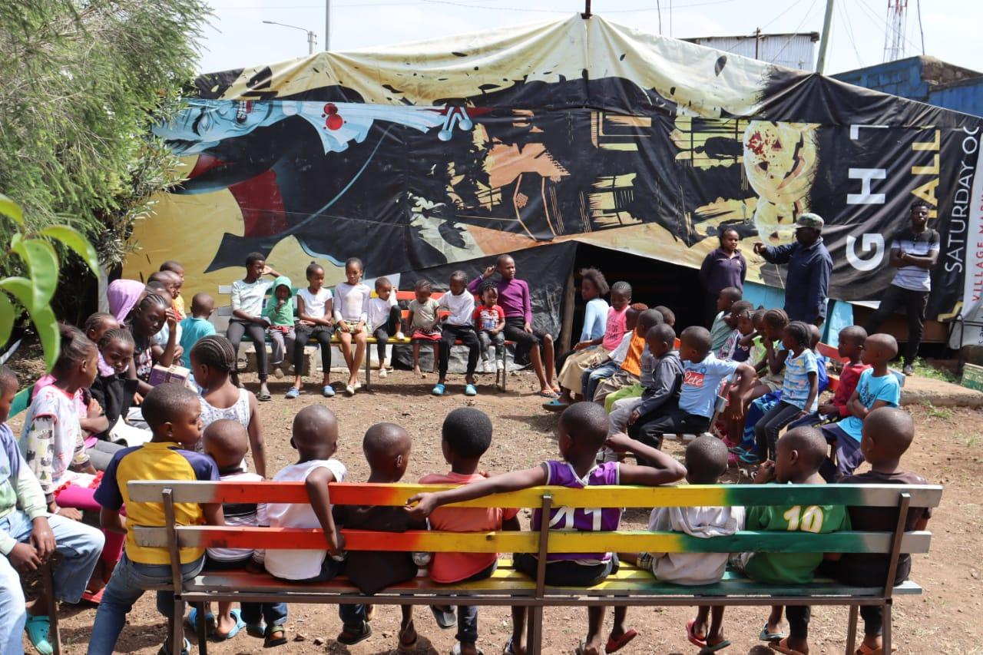
What are frugal innovations?
Type | Indicators
Mindset | Frame challenges as opportunities Innovations at the margin
Process | Indigenous Affordable Accessible Adaptive
Outcome | Simple Good enough Robust
Community space Mustard Seed, Dandora
(Wilde Ganzen, Daida, CFIA, VCC)

Slide 5
What we do
Networks
CFIA
VCC
Closer Cities
Nairobi, Rotterdam, The Haque
Ongoing studies
International study
Mustard Seeds, Dandora
Resilience in Mathare and Korogocho
Heat effects in The Haque
Community resilience in Rotterdam
Capacity building & impact

Slide 6
Initial findings
Multilevel coping mechanisms
Households
Frugal mindset and processes but often low quality
Informal collective action
Invisible and unsupported
temporary
Backbone of a resilient informal settlement
Formal collective action
By existing CBOs, churches, sport clubs
Use existing networks
Higher quality
No trust in government
‘Frugalise’ external support
Local governments
Their support is much needed!
Responds is slow and untargeted
Weak networks, weak trust
Questions to iNGO’s
How to improve quality of household coping mechanisms?
How to recognize and support informal collective action?
How to support faster and more flexibly without corruption and low quality?
How to connect? (boundary spanning)

Slide 7
Conditions for resilient informal settlements
Conditions
Context matters
Location creates opportunity
More dense and urbanized, the more complex and networked
Capacity & network development
CBO’s adjust external support
System change is rare, but needed
Dilemma for iNGO’s
Long term commitment to develop capacity, networks & system change
Immediate response to new initiatives in new settlements

Slide 8
Tentative conclusions
Coping mechanisms
Multilevel and unconnected
Frugal innovation: up quality and use as starting point
Capacity and networks (social capital)
Three roles of iNGO’s in resilience
Deepen: To be able to respond fast to a crisis requires long-term commitment
Capacitate local partners and polycentric networks
Map frugal household and collective actions
Broaden: fast responses to new initiatives and new informal settlements increases risks of failure
System change: long-term joint effort at multiple levels including local governments

